Slide 1

Demand Forecasting
Submitted by Thanima Firoz

Slide 2
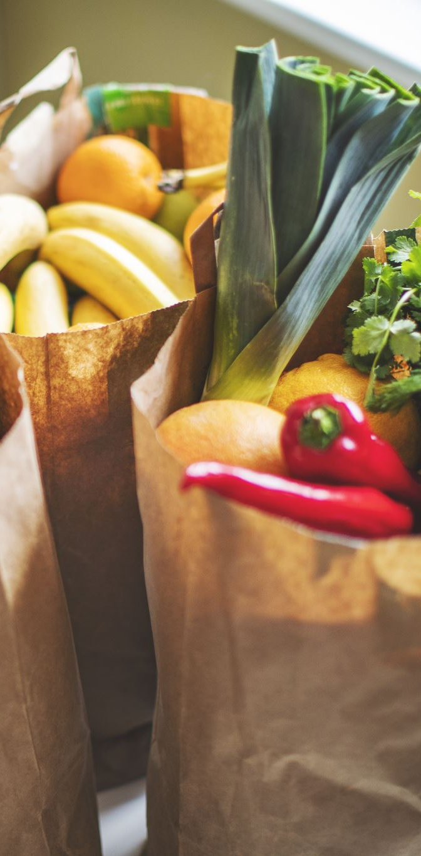
About the dataset
The dataset belongs to a meal delivery company that operates in multiple cities. They have various fulfillment centers in these cities for dispatching meal orders to their customers. The objective of the project is to forecast the demand for upcoming weeks so that these centers will plan the stock of raw materials accordingly.
Client – Meal Delivery Company
Dataset: https://www.kaggle.com/datasets/kannanaikkal/food-demand-forecasting

Slide 3

Objective
To Provide five actionable Insights about the dataset.
The dataset consists of 5 CSV files.
Fulfillment Center Info
Meal info
Sample Submission
Test
Train

Slide 4
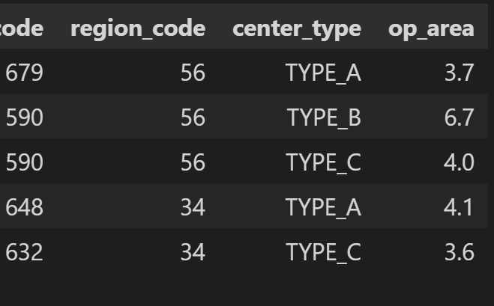
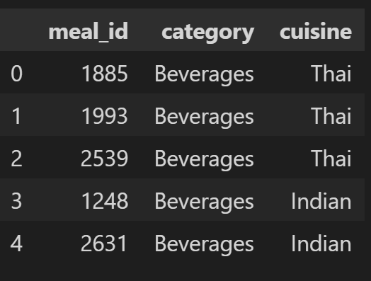
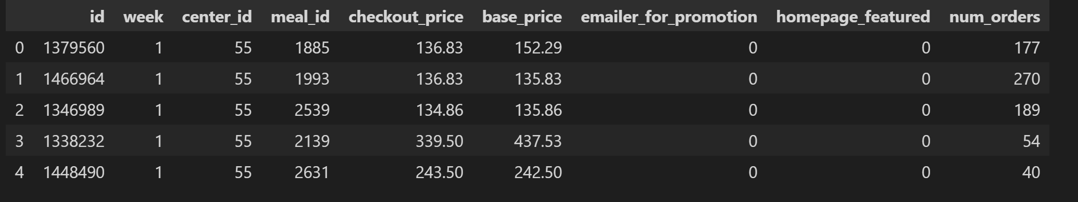
Dataset
The dataset consists of 5 CSV files :
Fulfillment Center Info
Meal info
Sample Submission
Test
Train

Slide 5
Outliers and Missing Records
Outliers:
○ Record with 24299 number of orders
○ Record with 2.97 checkout price
Missing records:
○ No Orders of some product-center combination for some week

Slide 6
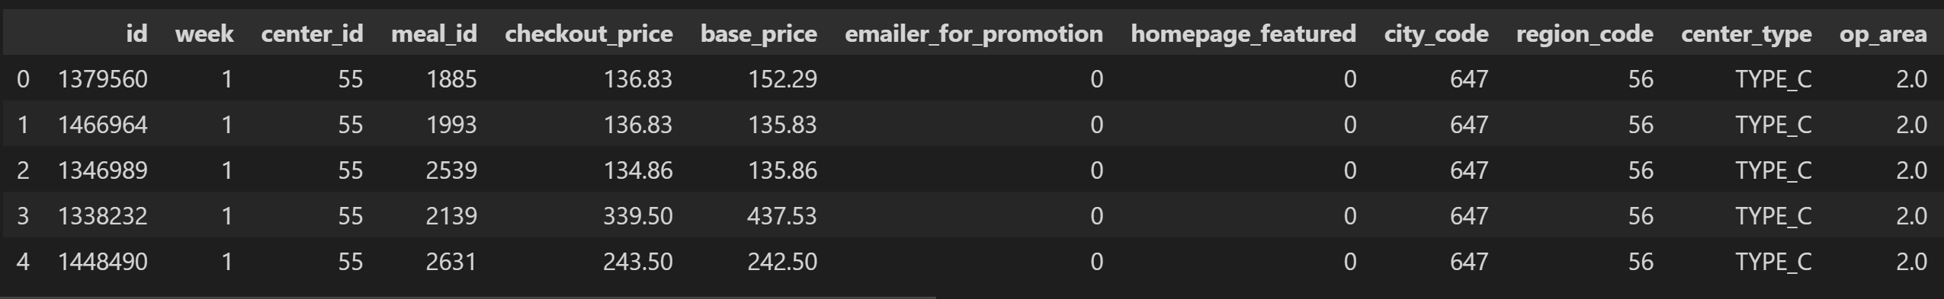
Merged Data

Slide 7

Feature extraction
Year
Month
Quarter
Week in a month

Slide 8

Actionable Insights

Slide 9
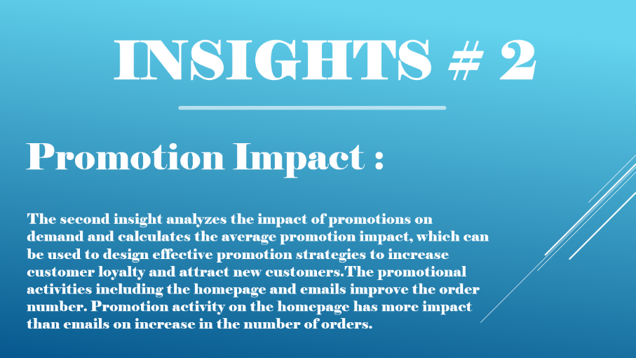
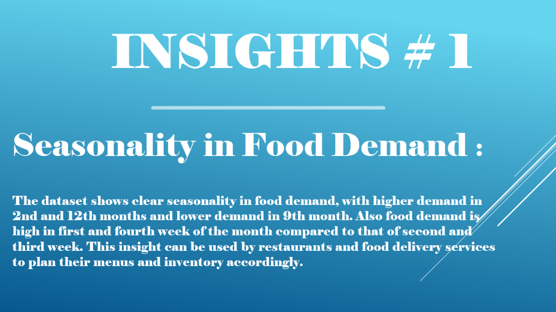
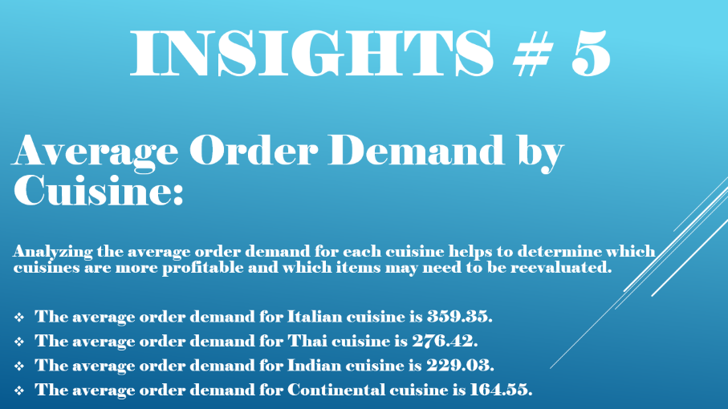
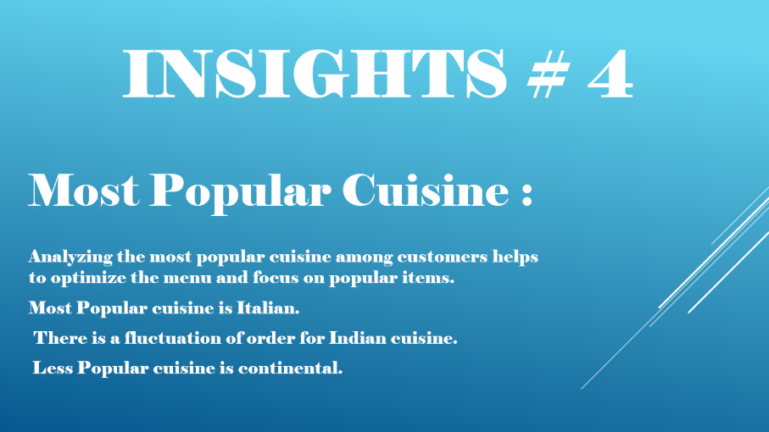
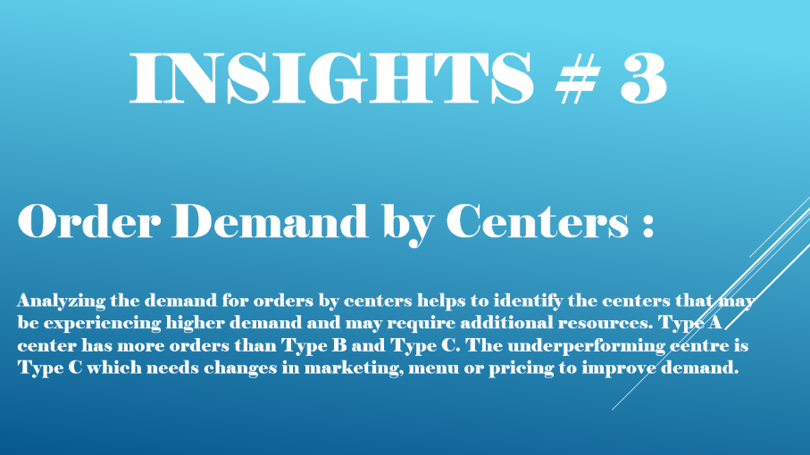

Slide 10
Insights # 1
Seasonality in Food Demand :
The dataset shows clear seasonality in food demand, with higher demand in 2nd and 12th months and lower demand in 9th month. Also food demand is high in first and fourth week of the month compared to that of second and third week. This insight can be used by restaurants and food delivery services to plan their menus and inventory accordingly.

Slide 11
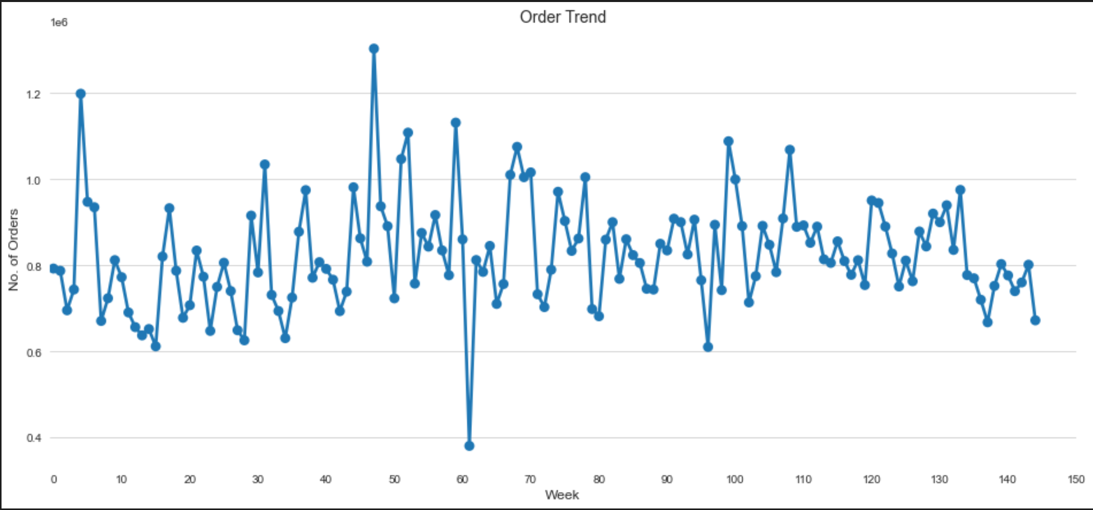
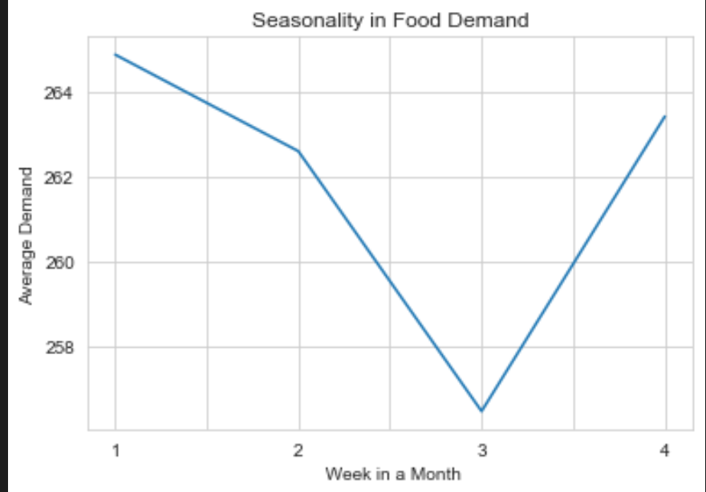
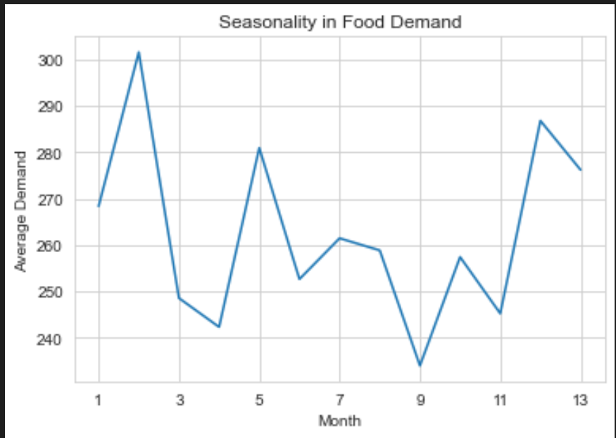
Week 62 has lowest orders
Weeks 5 and 48 have the highest orders because of increase in promotions by emails
Start and end week of the month has highest orders compared to other weeks.
Month 2 have highest orders
Month 9 have lowest orders

Slide 12
Insights # 2
Promotion Impact :
The second insight analyzes the impact of promotions on demand and calculates the average promotion impact, which can be used to design effective promotion strategies to increase customer loyalty and attract new customers.The promotional activities including the homepage and emails improve the order number. Promotion activity on the homepage has more impact than emails on increase in the number of orders.

Slide 13
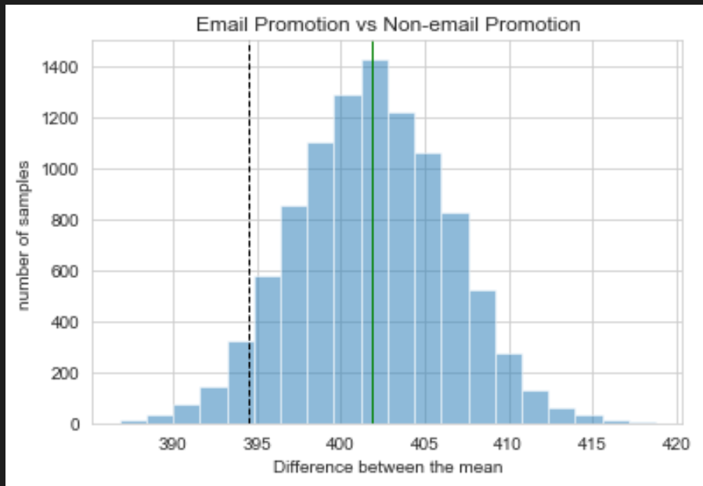
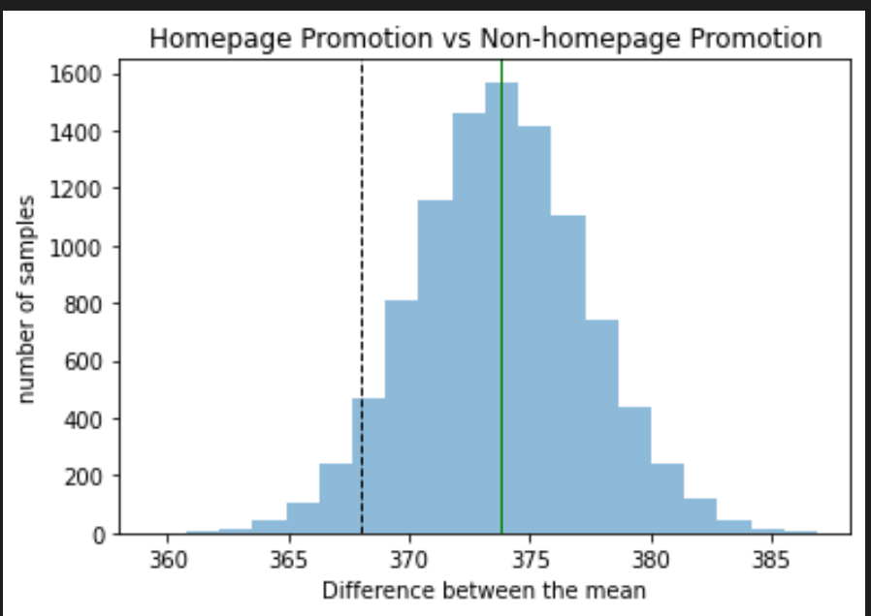
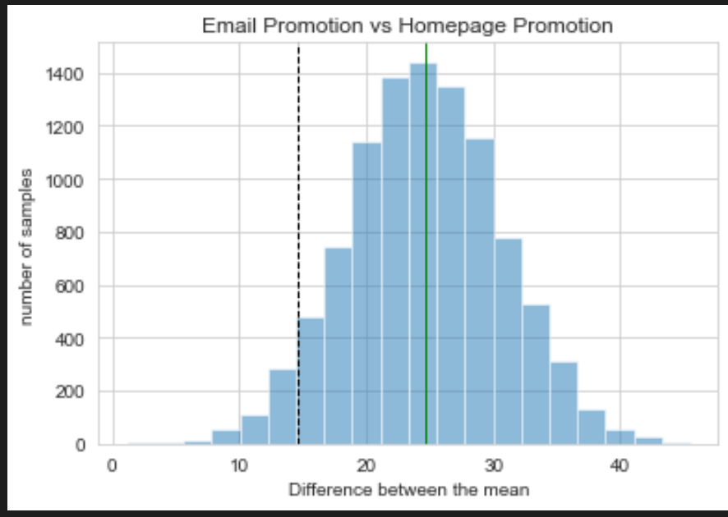
Promotions via email increase the number of orders.
Promotions in the home page has more impact than emails.
Promotions via homepage increases the number of orders.

Slide 14
Insights # 3
Order Demand by Centers :
Analyzing the demand for orders by centers helps to identify the centers that may be experiencing higher demand and may require additional resources. Type A center has more orders than Type B and Type C. The underperforming centre is Type C which needs changes in marketing, menu or pricing to improve demand.

Slide 15
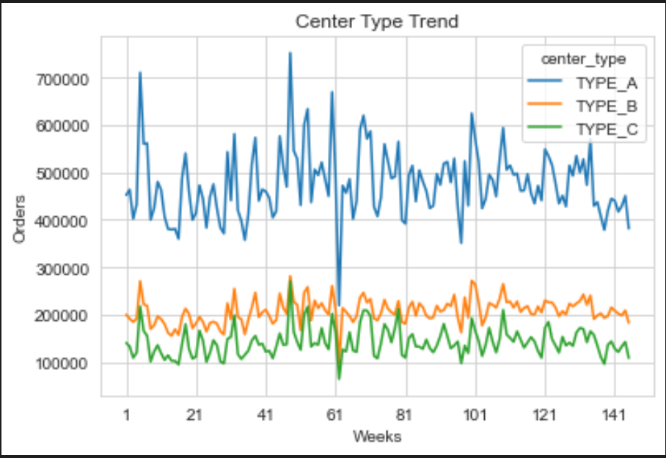
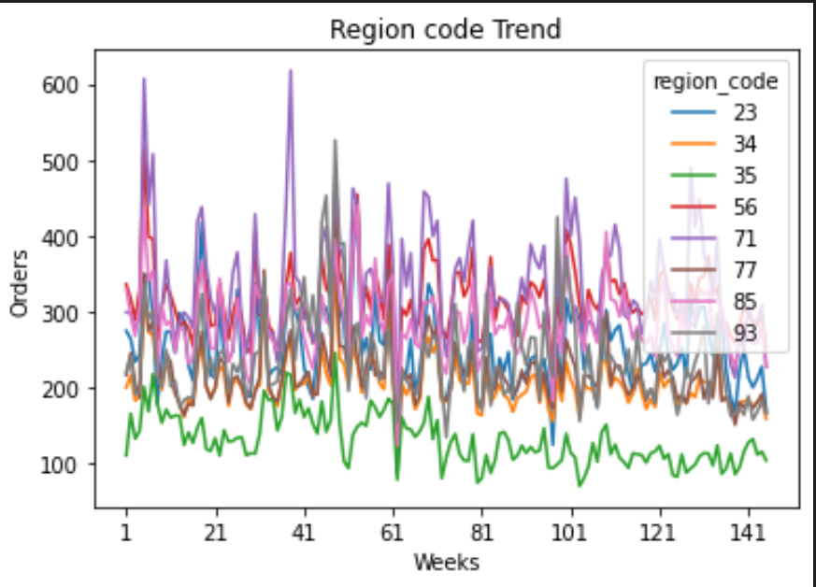
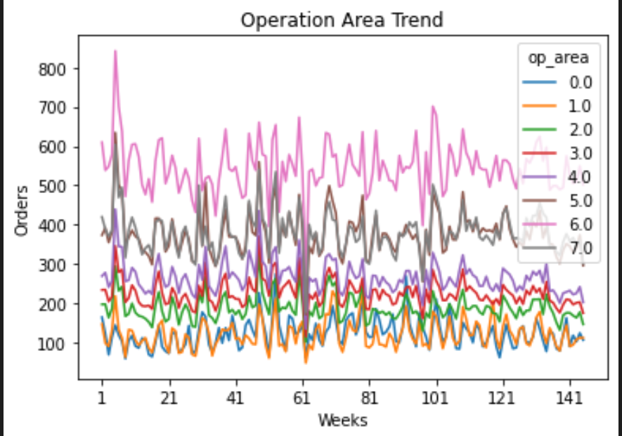
Type A has more orders.
Type C has lowest orders.
Region code 35 has lowest
orders.
Fluctuations for almost all
region.
Positive correlation between
Operation Area and Orders

Slide 16
Insights # 4
Most Popular Cuisine :
Analyzing the most popular cuisine among customers helps to optimize the menu and focus on popular items.
Most Popular cuisine is Italian.
There is a fluctuation of order for Indian cuisine.
Less Popular cuisine is continental.

Slide 17
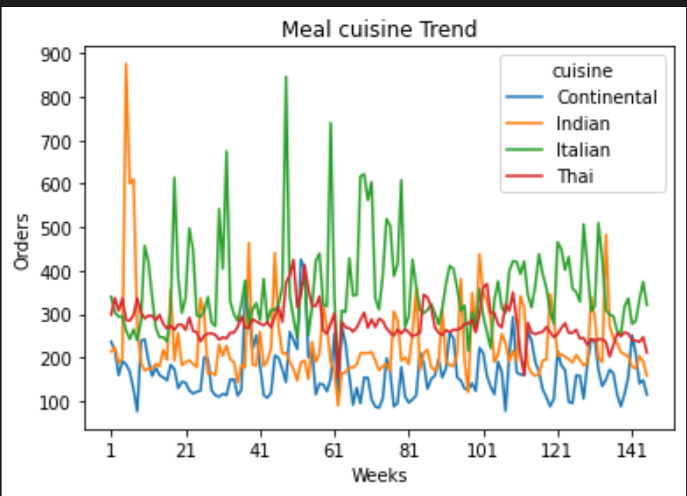
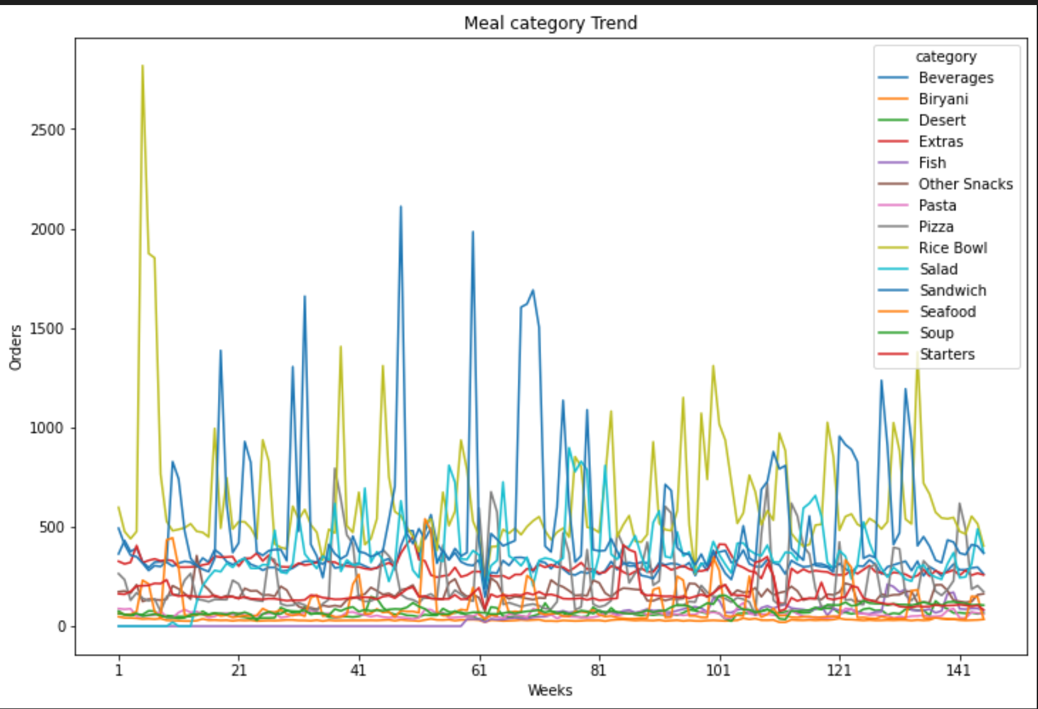
Italian meals and Beverages has high Orders
Orders for Salad increased after week 18.
Fluctuations for Indian meals, Rice Bowl and Sandwich.

Slide 18
Insights # 5
Average Order Demand by Cuisine:
Analyzing the average order demand for each cuisine helps to determine which cuisines are more profitable and which items may need to be reevaluated.
The average order demand for Italian cuisine is 359.35.
The average order demand for Thai cuisine is 276.42.
The average order demand for Indian cuisine is 229.03.
The average order demand for Continental cuisine is 164.55.

Slide 19
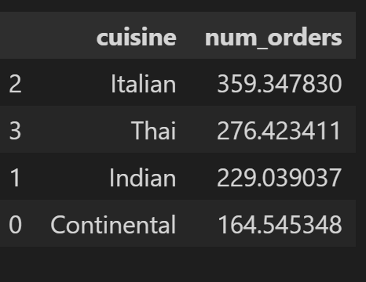
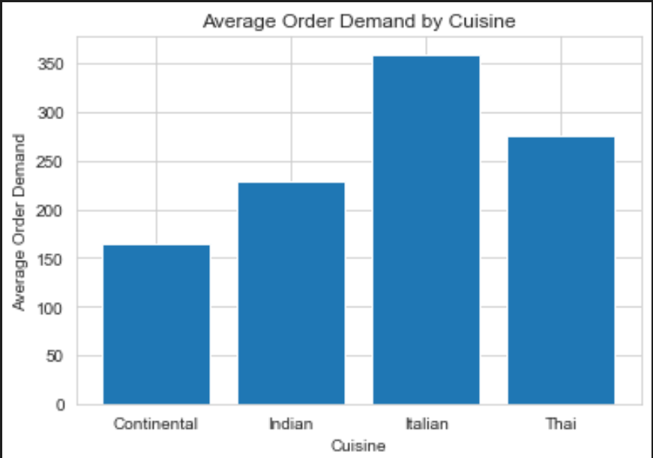

Slide 20

Thank You

